Slide 1

CNSCC.203 Computer Networks The Link Layer & LANs
Muhammad Azhar Iqbal
azhar.iqbal@lancaster.ac.uk
Credit goes to Dr. Matt Broadbent and Dr. Vasileios Giotsas at SCC for designing module SCC.203.

Slide 2


Roadmap
introduction
error detection, correction
multiple access protocols
LANs
addressing, ARP
Ethernet
switches
Chapter 6.1- 6.4.3

Slide 3
















Link layer: introduction
terminology:
any device that runs a link-layer protocol: nodes
communication channels that connect adjacent nodes along communication path: links
wired
wireless
layer-2 packet: frame, encapsulates datagram
mobile network
national or global ISP
任何运行链路层协议的设备:节点
沿着通信路径连接相邻节点的通信通道:链路（有线，无线）
在第二层，将数据包封装成帧
链路层负责通过链路将数据报从一个节点传输到物理上相邻的节点
datacenter
network
link layer has responsibility of
transferring datagram from one node
to physically adjacent node over a link
enterprise
network

Slide 4
Link layer: context
datagram transferred by different link protocols over different links:
e.g., WiFi on first link, Ethernet on next link
each link protocol provides different services
e.g., may or may not provide reliable data transfer over link
transportation analogy:
trip from Lancaster to Weihai
taxi: Lancaster to Manchester
plane: Manchester to Beijing
train: Beijing to Weihai
tourist = datagram
transport segment = communication link
transportation mode = link-layer protocol
travel agent = routing algorithm
不同链路协议在不同链路上传输的数据报
WiFi在第一条链路，以太网在下条链路
每种链路协议提供不同的服务例如，
可以或不 提供可靠的数据传输通过链路

Slide 5


Link layer: services
帧、链接访问:
封装数据报到帧，添加报头，预告片
“MAC”地址在帧头标识源，目的
通道访问如果共享媒体
相邻节点间可靠的传输
使用确认和重传
很少用于低误码链路，包括光纤、同轴电缆和许多双绞线铜链路
无线链路:错误率高
…
framing, link access:
encapsulate datagram into frame, adding header, trailer
“MAC” addresses in frame headers identify source, destination (different from IP address!)
channel access if shared medium
reliable delivery between adjacent nodes
Using acknowledgements and retransmissions
seldom used on low bit-error links including fiber, coax, and many twisted-pair copper links
wireless links: high error rates
…

Slide 6
Link layer: services (more)
error detection and correction:
errors caused by signal attenuation, noise.
receiver identifies and corrects bit error(s) without retransmission
…
…
错误检测和修正:
信号衰减、噪声引起的误差
接收器识别和纠正比特错误而不重传

Slide 7
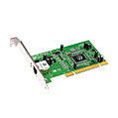
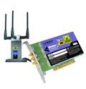

Where is the link layer implemented?
在每一个主机
链路层实现在网络适配器(网络接口卡(NIC))或芯片上
以太网卡、WiFi卡或以太芯片组
实现链接，物理层
连接到主机系统总线
硬件、软件、固件的组合
in each-and-every host
link layer implemented in network adapter (network interface card (NIC)) or on a chip
Ethernet card, WiFi card or Ethernet chipset
implements link, physical layer
attaches into host’s system buses
combination of hardware, software, firmware
application
transport
network
link
cpu
memory
host bus
(e.g., PCI)
controller
link
physical
physical
network interface card

Slide 8
Interfaces communicating
application
transport
network
link
application
transport
network
link
cpu
memory
memory
CPU
datagram
link_{h}
datagram
controller
controller
datagram
link_{h}
link
physical
link
physical
physical
physical
接收方
寻找错误，可靠的数据传输，流量控制
提取数据报，传递到接收端的上层
发送方
将数据报封装在帧中，
增加了错误检查位、可靠数据传输、流量控制
sending side:
encapsulates datagram in frame
adds error checking bits, reliable data transfer, flow control, etc.
receiving side:
looks for errors, reliable data transfer, flow control, etc.
extracts datagram, passes to upper layer at receiving side

Slide 9
Roadmap
introduction
error detection, correction
multiple access protocols
LANs
addressing, ARP
Ethernet
switches

Slide 10
Error detection
EDC:错误检测和校正比特
D:受错误检查保护的数据，可能包括报头字段
EDC: error detection and correction bits (e.g., redundancy)
D: data protected by error checking, may include header fields
不是完全有效
datagram
datagram
Error detection not 100% reliable!
protocol may miss some errors, but rarely
larger EDC field yields better detection and correction
otherwise
all
bits in D’
OK
?
N
detected
error
d data bits
D
EDC
D’
EDC’
bit-error prone link

Slide 11
Parity checking
奇偶校验检查
单一的奇偶性:
仅检测单一错误
二维的奇偶性:
检测与发现单一比特错误
single bit parity:
detect single bit errors
two-dimensional bit parity:
detect and correct single bit errors
14% overhead
row parity
0111000110101011
1
d_{1,1}
. . .
d_{1,j}
d_{1,j+1}
d data bits
d_{2,1}
. . .
d_{2,j}
d_{2,j+1}
1：前面1的数量为奇数
0：否则
parity
bit
. . .
. . .
. . .
. . .
d_{i,1}
. . .
d_{i,j}
d_{i,j+1}
column
parity
d_{i+1,1}
. . .
d_{i+1,j}
d_{i+1,j+1}
Even parity: add an extra bit called parity bit to keep the number of 1’s even
Detects 1-bit errors and some 2-bit errors
Not reliable against bursty errors
no errors:
1 0 1 0 1 1
detected
and
correctable
single-bit
error:
1 0 1 0 1 1
1 1 1 1 0 0
1 0 1 1 0 0
parity
error
0 1 1 1 0 1
0 1 1 1 0 1
1 0 1 0 1 0
1 0 1 0 1 0
parity
error

Slide 12
Internet checksum (review)
Goal: detect errors (i.e., flipped bits) in transmitted segment
sender:
treat contents of UDP segment (including UDP header fields and IP addresses) as sequence of 16-bit integers
checksum: addition (one’s complement sum) of segment content
checksum value put into UDP checksum field
receiver:
compute checksum of received segment
check if computed checksum equals checksum field value:
not equal - error detected
equal - no error detected. But maybe errors nonetheless?

Slide 13

Cyclic Redundancy Check (CRC)
循环冗余检查
Uses field theory to compute a semi-unique value for a given message
Much better performance than previous approaches
Fixed size overhead per frame
Quick to implement in hardware
Only 1 in $2^{32}$ chance of missing an error with 32-bit CRC
利用场理论计算给定消息的半唯一值
性能比以前的方法好得多
固定大小的开销每帧
在硬件上快速实现
32位CRC只有1 / 2^32的机会遗漏一个错误

Slide 14
Cyclic Redundancy Check (CRC)
more powerful error-detection coding
D: data bits (view data bits D as a binary number)
G: sender and receiver agree on a bit pattern (generator), of r+1 bits (given)
协商一个G，有r+1比特
附加比特R，有r比特
无差错：模2算术被G整除
可以检测 <r+1比特错误
广泛应用
r CRC bits
d data bits
D
R
bit pattern
<D,R> = D 2^{r} XOR R
formula for bit pattern
*
goal: choose r CRC bits, R, such that <D,R> exactly divisible by G (mod 2)
receiver knows G, divides <D,R> by G. If non-zero remainder: error detected!
can detect all burst errors less than r+1 bits
widely used in practice (Ethernet, 802.11 WiFi)

Slide 15
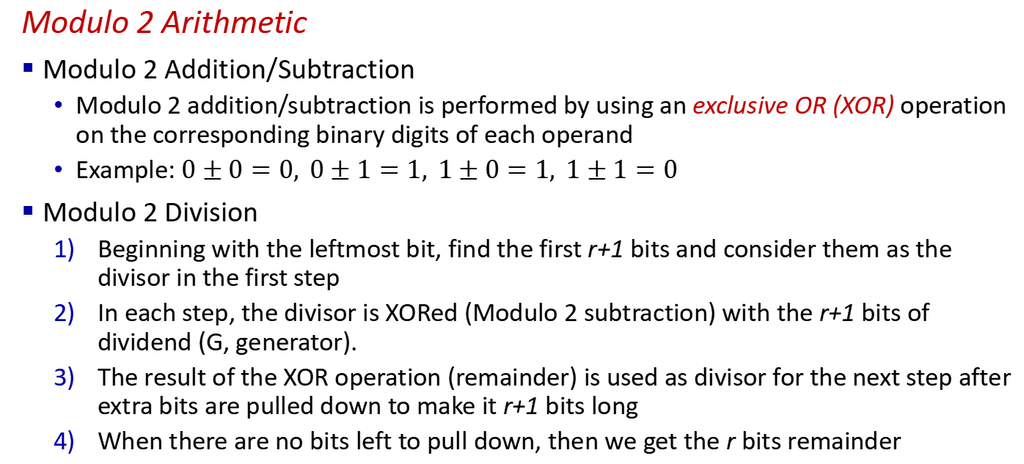
Cyclic Redundancy Check (CRC)
Modulo 2 Arithmetic
Modulo 2 Addition/Subtraction
Modulo 2 addition/subtraction is performed by using an exclusive OR (XOR) operation on the corresponding binary digits of each operand
Example: $0±0=0, 0±1=1, 1±0=1, 1±1=0$
Modulo 2 Division
Beginning with the leftmost bit, find the first r+1 bits and consider them as the divisor in the first step
In each step, the divisor is XORed (Modulo 2 subtraction) with the r+1 bits of dividend (G, generator).
The result of the XOR operation (remainder) is used as divisor for the next step after extra bits are pulled down to make it r+1 bits long
When there are no bits left to pull down, then we get the r bits remainder
从左边最高位开始，找到前r+1比特作为除数
除数与被除数（G)异或
结果作为除数，补充至r+1位
不能借位是，获得r比特余数

Slide 16

Cyclic Redundancy Check (CRC): example
G
1
0
1
D = 101110
G = 1001
Generator polynomial: $x^{3}+x=1x^{3}+0x^{2}+0x^{1}+1x^{0}$
Since G is 4 bits long, the CRC bits are 3 bits.
0 1 1
1 0 0 1
1 0 1 1 1 0
0 0 0
1 0 0 1
1 0 1
D
2^{r}
0 0 0
*
1 0 1 0
G是4比特，因此R是4-1=3比特
在D末尾补充3个0
1 0 0 1
1 1 0
Append 3 bits of 0 at the end of data D
Divide the padded data by G using modulo-2 arithmetic
Finally, the 3-bit long remainder is the CRC bits which will be appended to the data bits at the sender side before the transmission
0 0 0
1 1 0 0
1 0 0 1
1 0 1 0
1 0 0 1
0 1 1
R

Slide 17
Cyclic Redundancy Check (CRC): example
G
Sender sends 101110011 where 101110 are the data bits and 011 are the CRC bits
Receiver repeats the calculation process on the received data with the same G
If the remainder is all zeros, then the receiver believes there is no error; otherwise, error can be detected.
1 0 0 1
1 0 1 1 1 0
0 1 1
…
0 0 0
OR
G
1 0 0 1
1 0 1 1 1 0
0 1 0
…
? ? ?

Slide 18
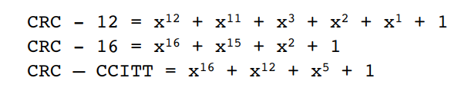
Some Standardized polynomials
Each of the CRC standards can detect burst errors of fewer than r+1 bits. (This means that all consecutive bit errors of r bits or fewer will be detected.)
Furthermore, under appropriate assumptions, a burst of length greater than r+1 bits may also be detected.
Each of the CRC standards can detect any odd number of bit errors.
<r+1比特错误一定可以被检测
>r+1比特错误可能被检测
每个CRC标准都可以检测到任何奇数位错误。

